Slide 1
SCREAMING FROG ANALYSIS
<Reshma Mulchandani>

Slide 2
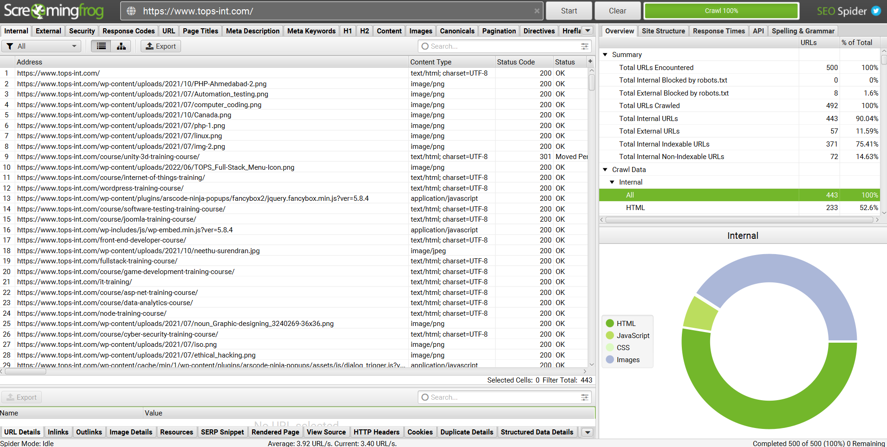
www.tops-int.com
Internal Links:

Slide 3
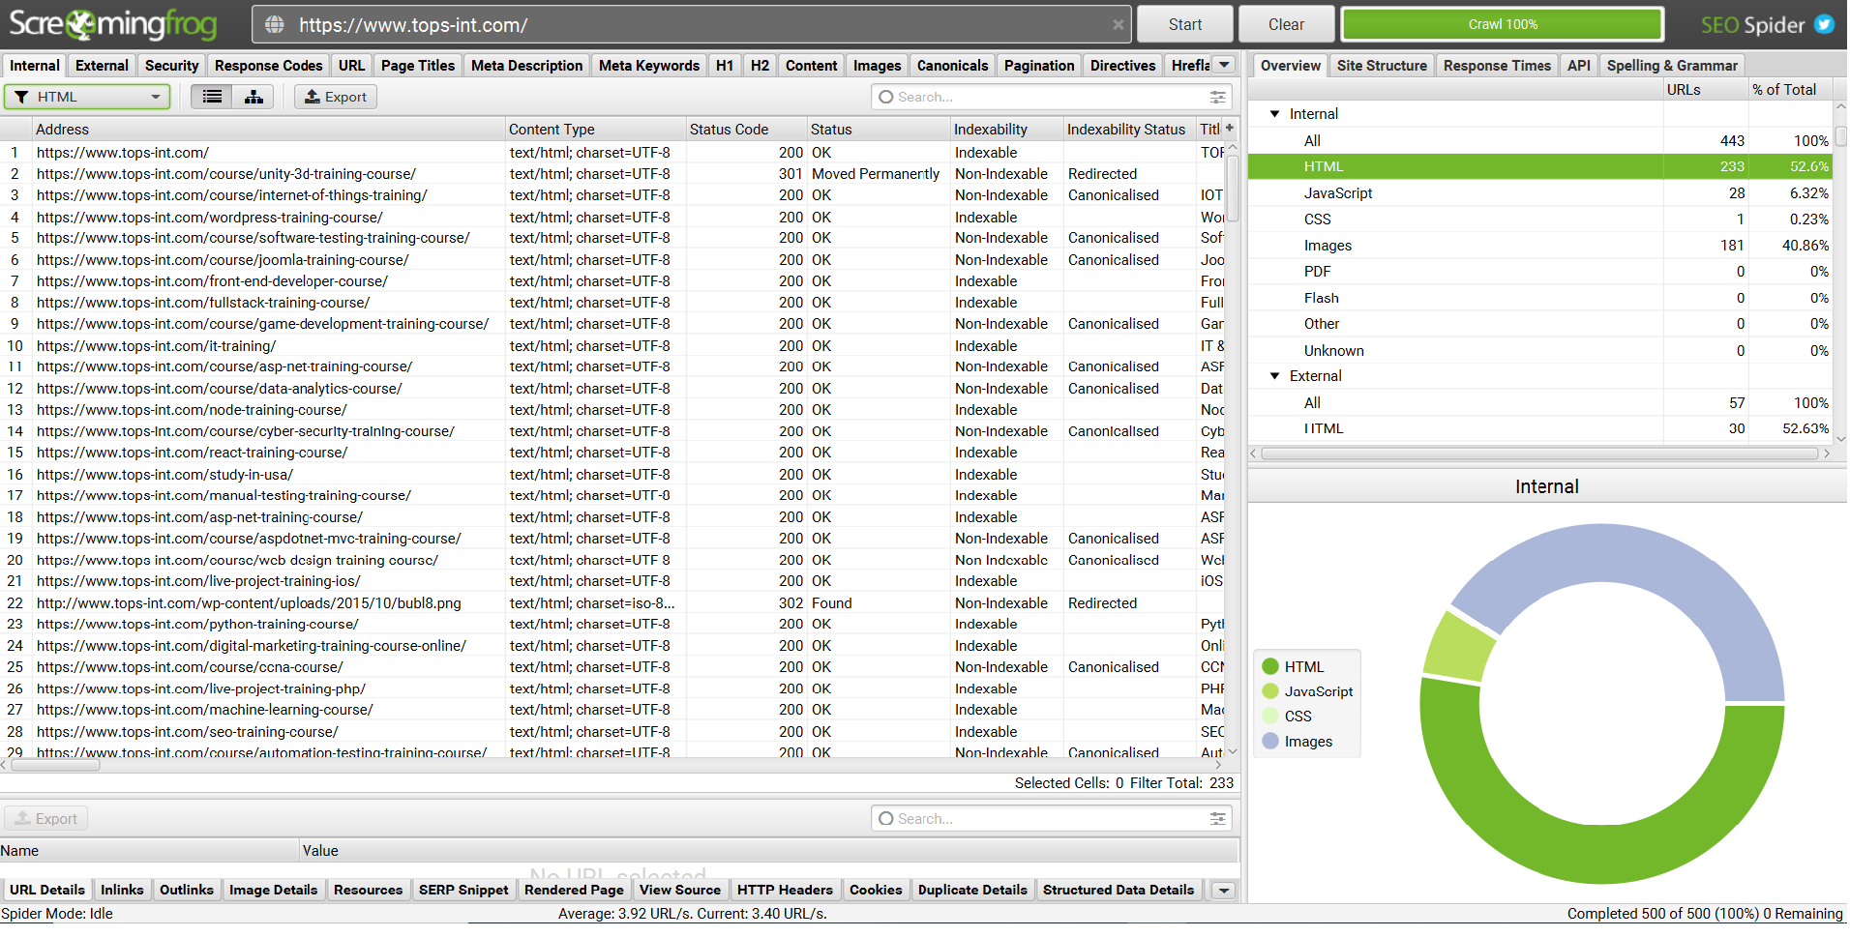
www.tops-int.com
Internal Links - HTML:

Slide 4
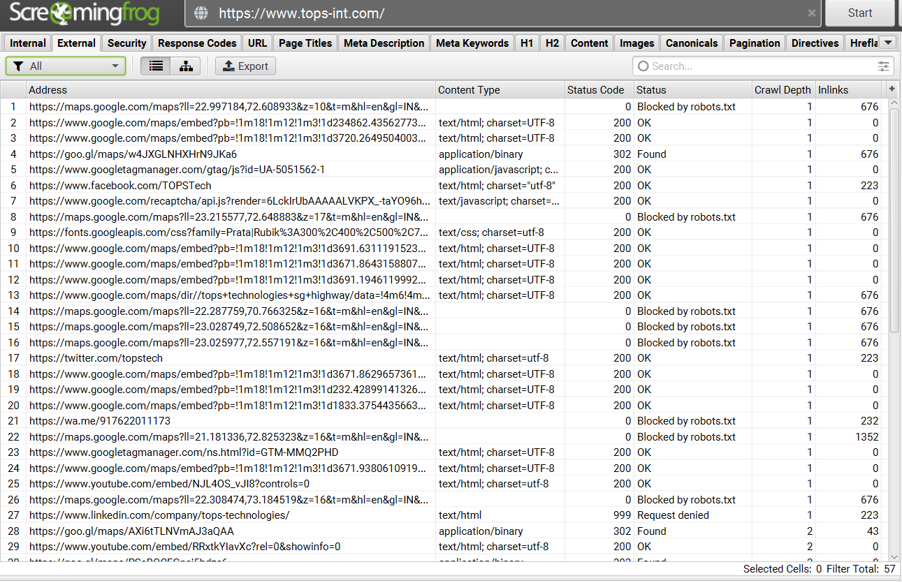
www.tops-int.com
External
Links:

Slide 5
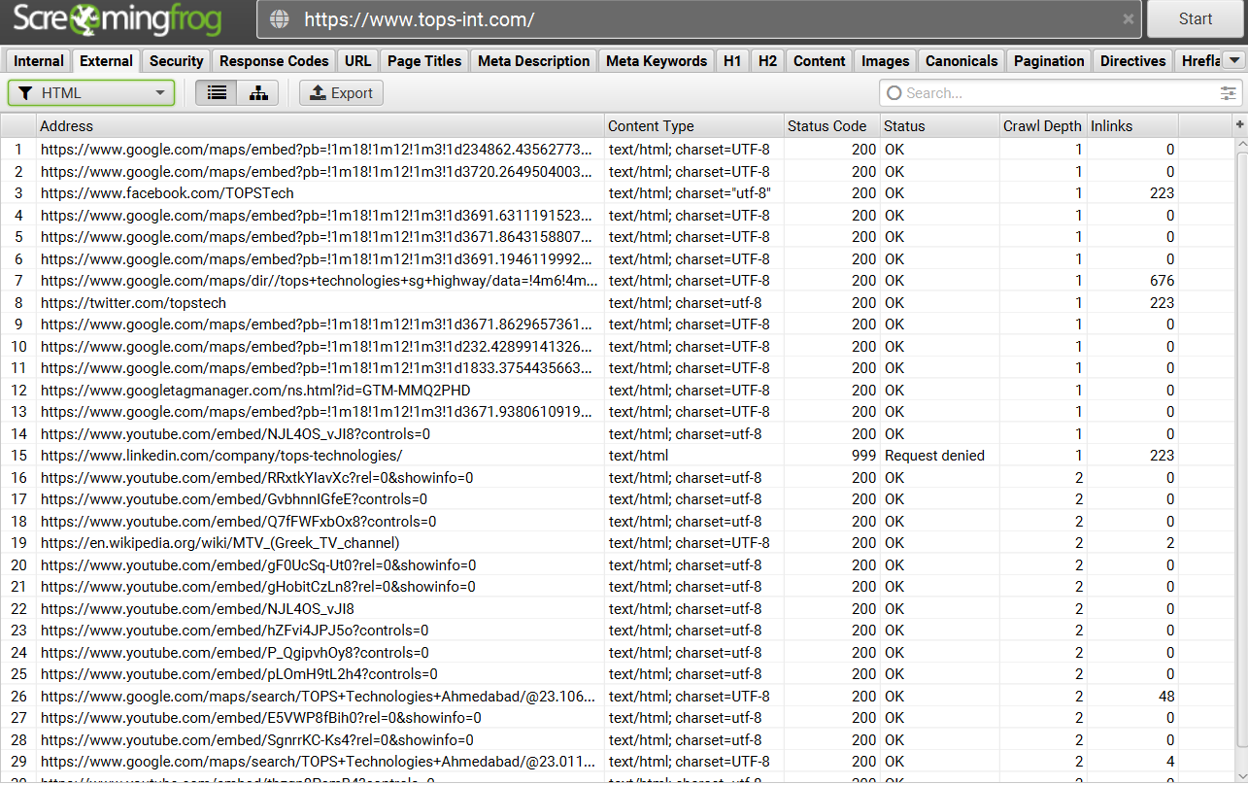
www.tops-int.com
External Links - HTML:

Slide 6
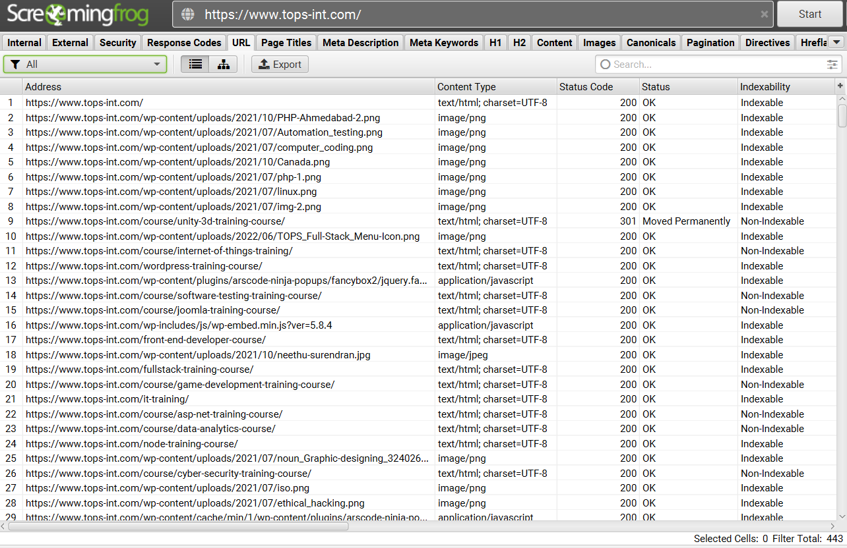
www.tops-int.com
URL –
All :

Slide 7
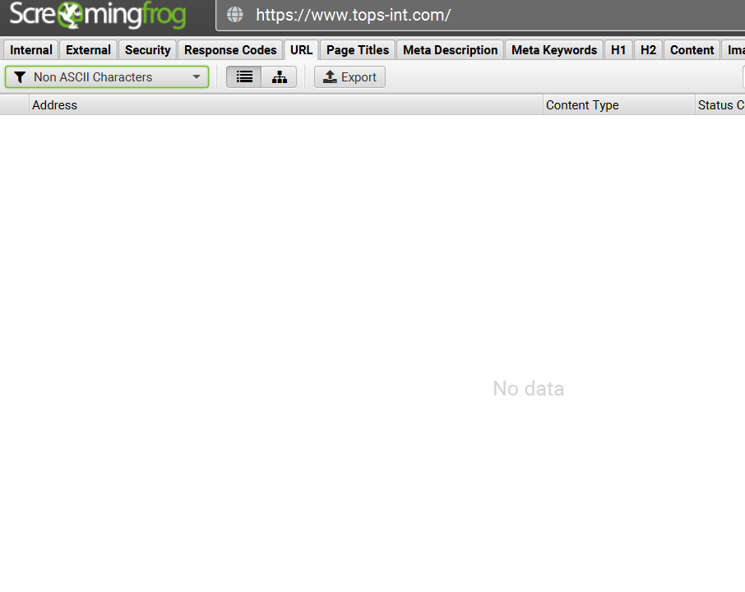
www.tops-int.com
URL –
Non ASCII
Characters:

Slide 8
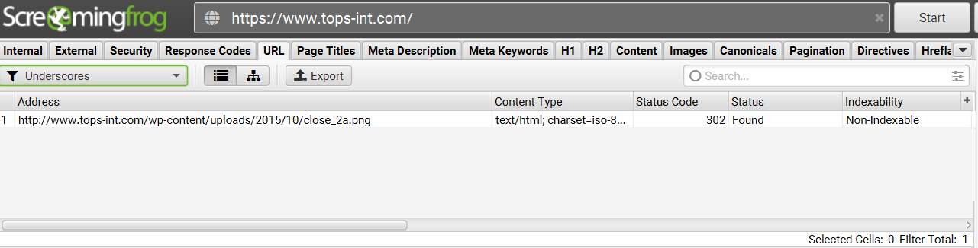
www.tops-int.com
URL – Underscores:

Slide 9
www.tops-int.com
URL – other options
URL Uppercase – no data
URL Multiple Slashes – no data
URL Repetitive Path – no data
URL Contains space – no data
URL Parameters – no data
URL Over 115 characters – no data

Slide 10
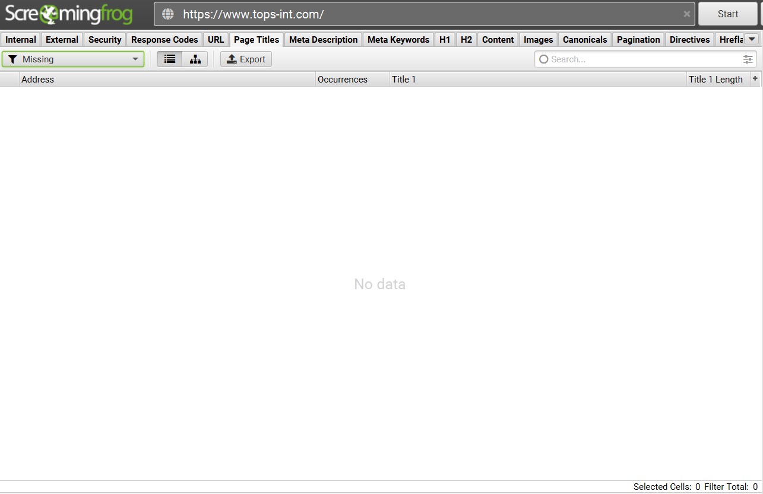
www.tops-int.com
Page Title –
Missing
&
Duplicate

Slide 11
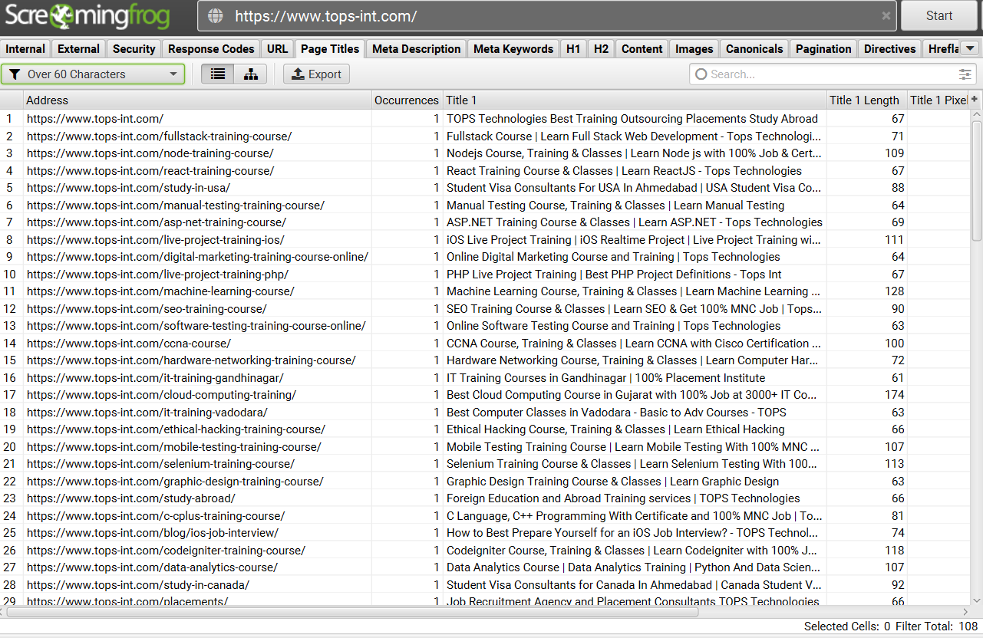
www.tops-int.com
Page Title –
Over 60
characters

Slide 12
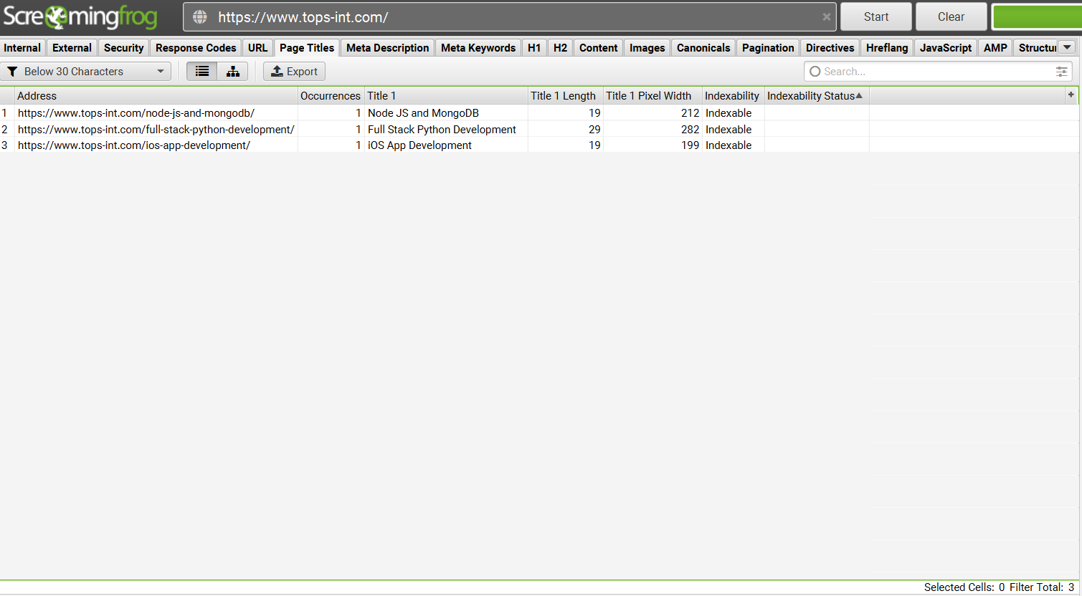
www.tops-int.com
Page Title –
Below 30
characters

Slide 13
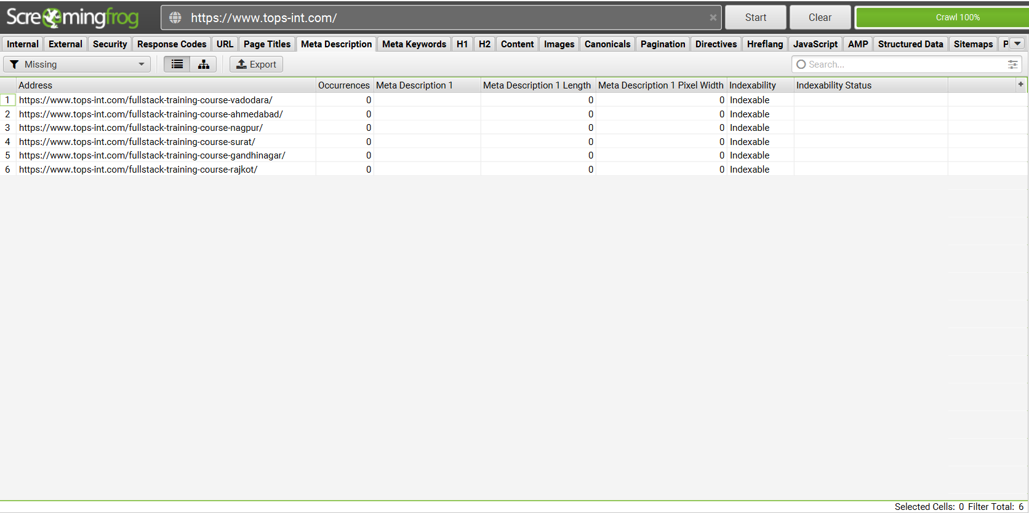
www.tops-int.com
Meta Description - Missing

Slide 14
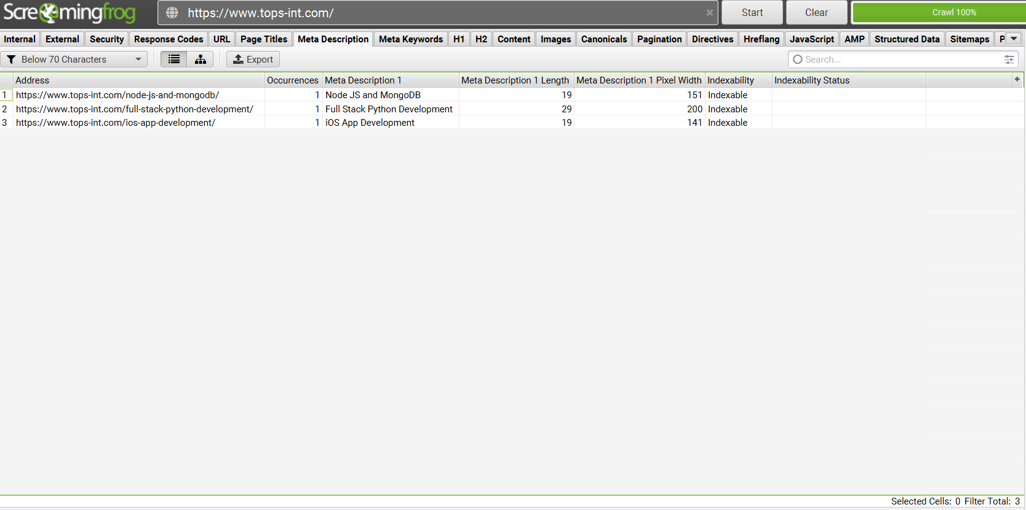
www.tops-int.com
Meta Description – Below 70
characters

Slide 15
www.tops-int.com
Page Title and Meta Description– other options
Page Title – same as H1– no data
Page Title - multiple– no data
Meta Decription – multiple – no data

Slide 16
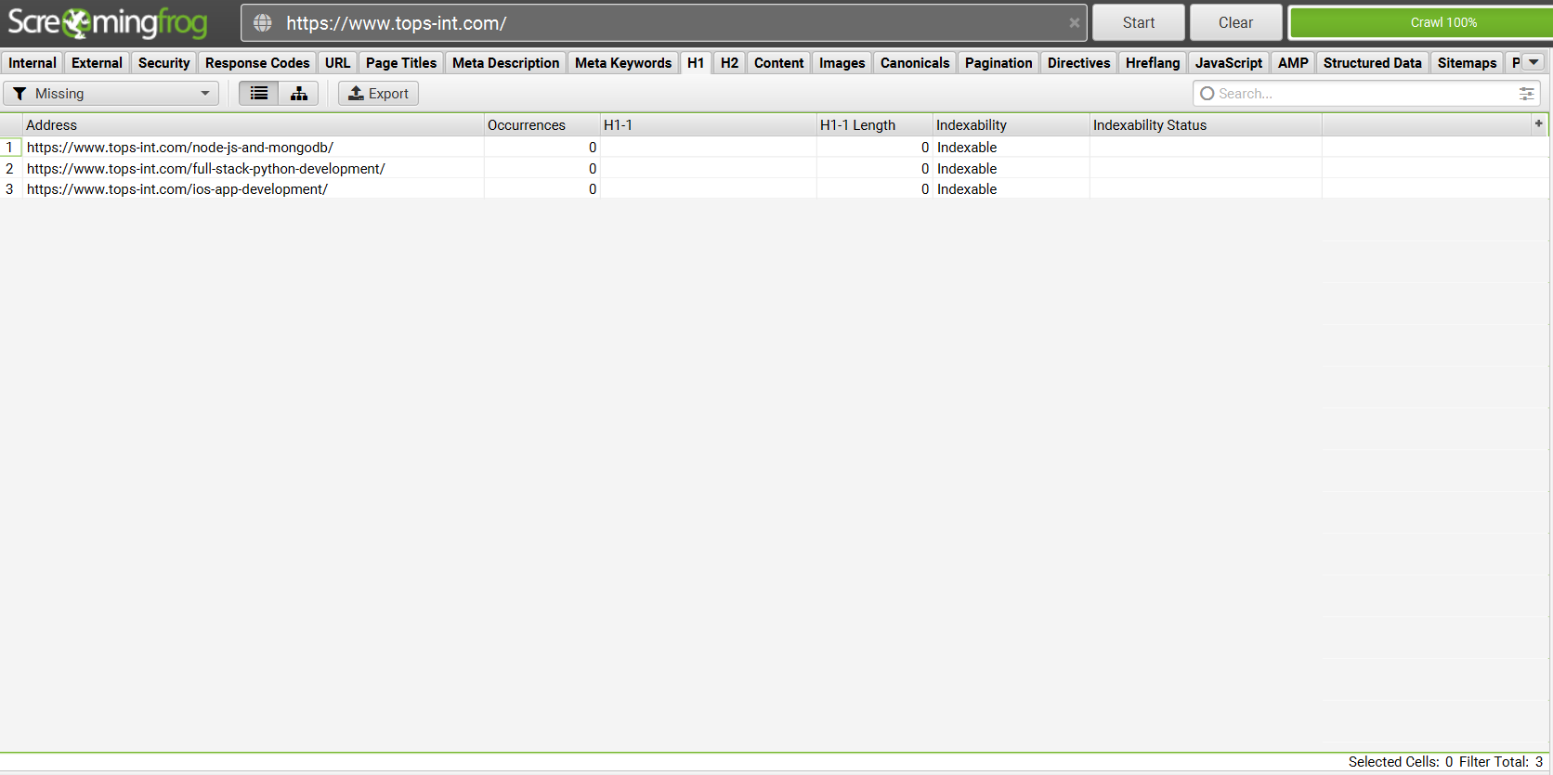
www.tops-int.com
H1-
Missing

Slide 17
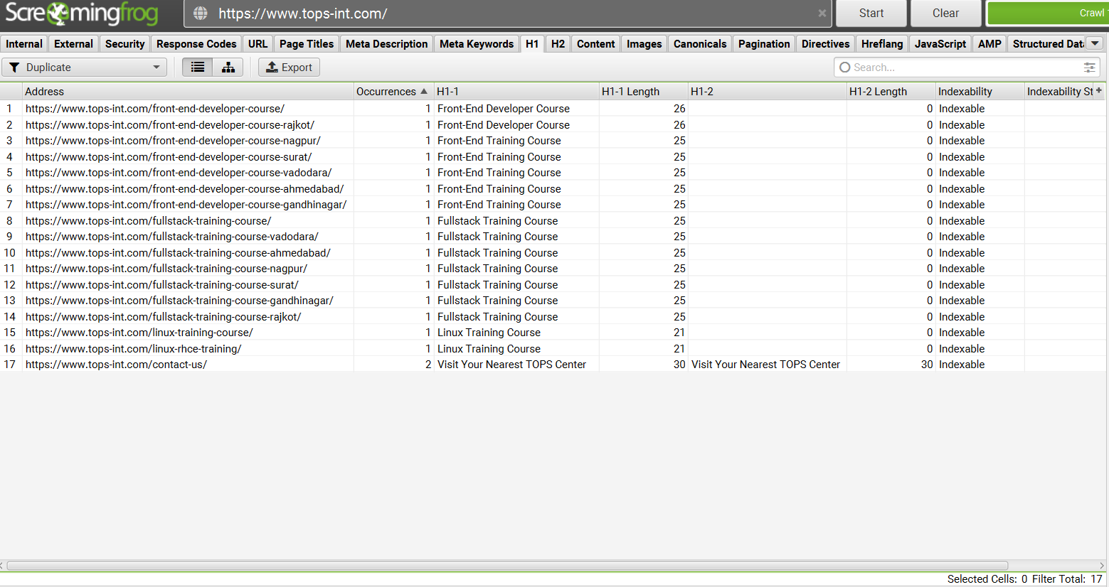
www.tops-int.com
H1-
Duplicate

Slide 18
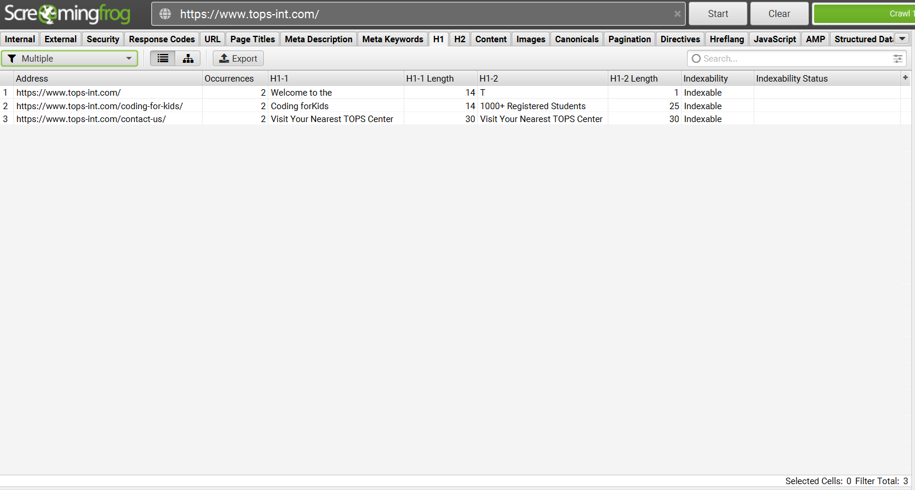
www.tops-int.com
H1-
Multiple

Slide 19
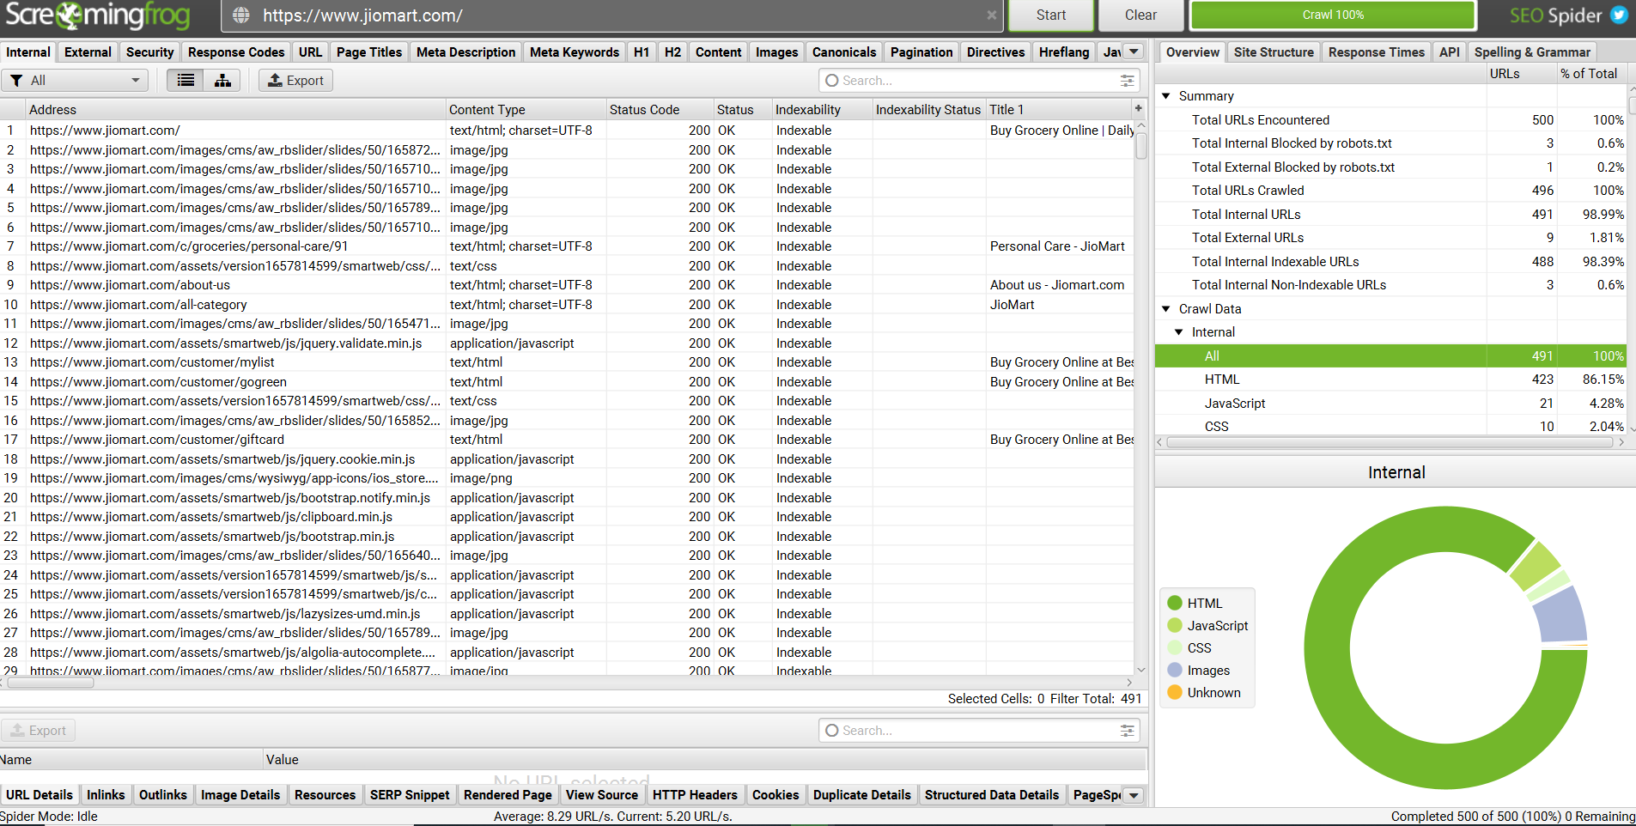
https://www.jiomart.com/
Internal Links:

Slide 20
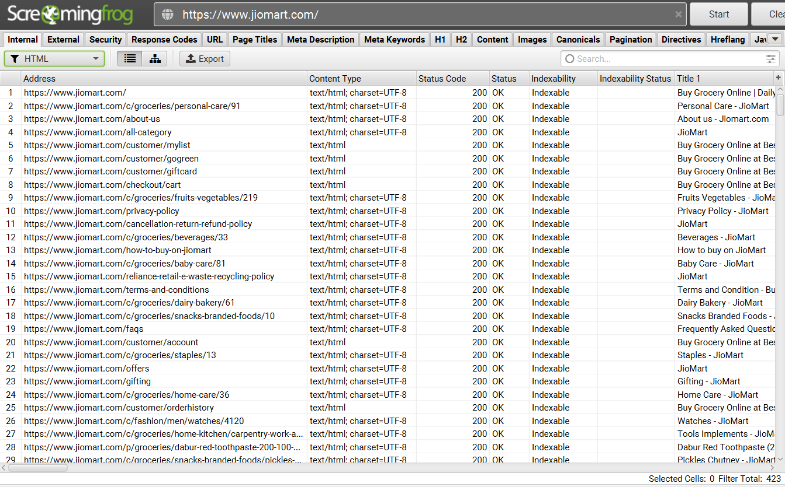
https://www.jiomart.com/
Internal Links –
HTML:

Slide 21
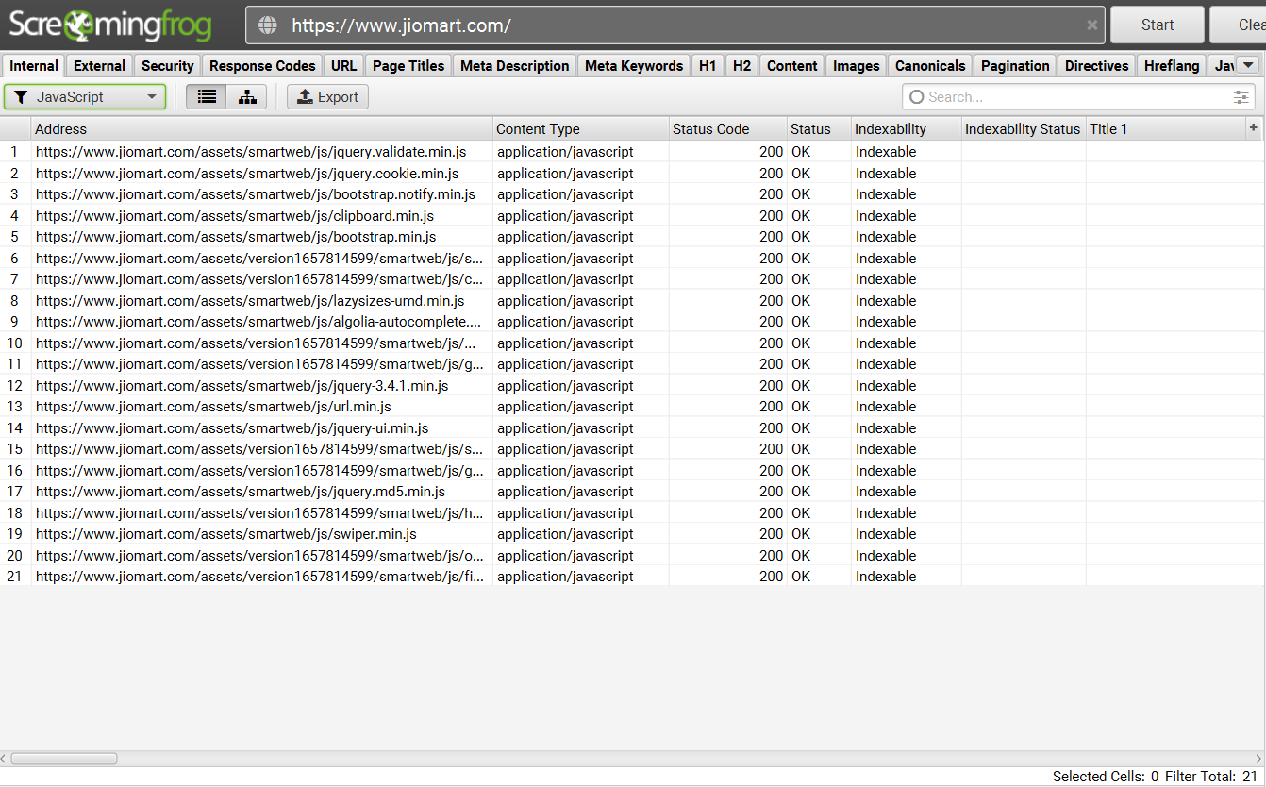
https://www.jiomart.com/
Internal Links –
JAVA:

Slide 22
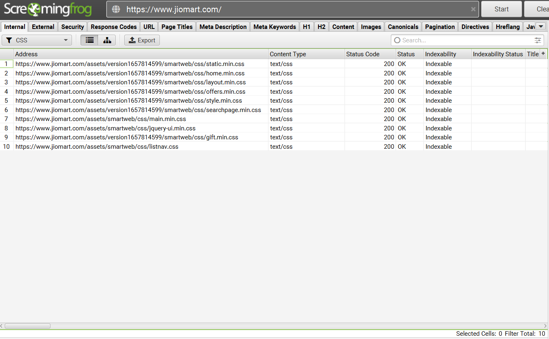
https://www.jiomart.com/
Internal Links –
CSS:

Slide 23
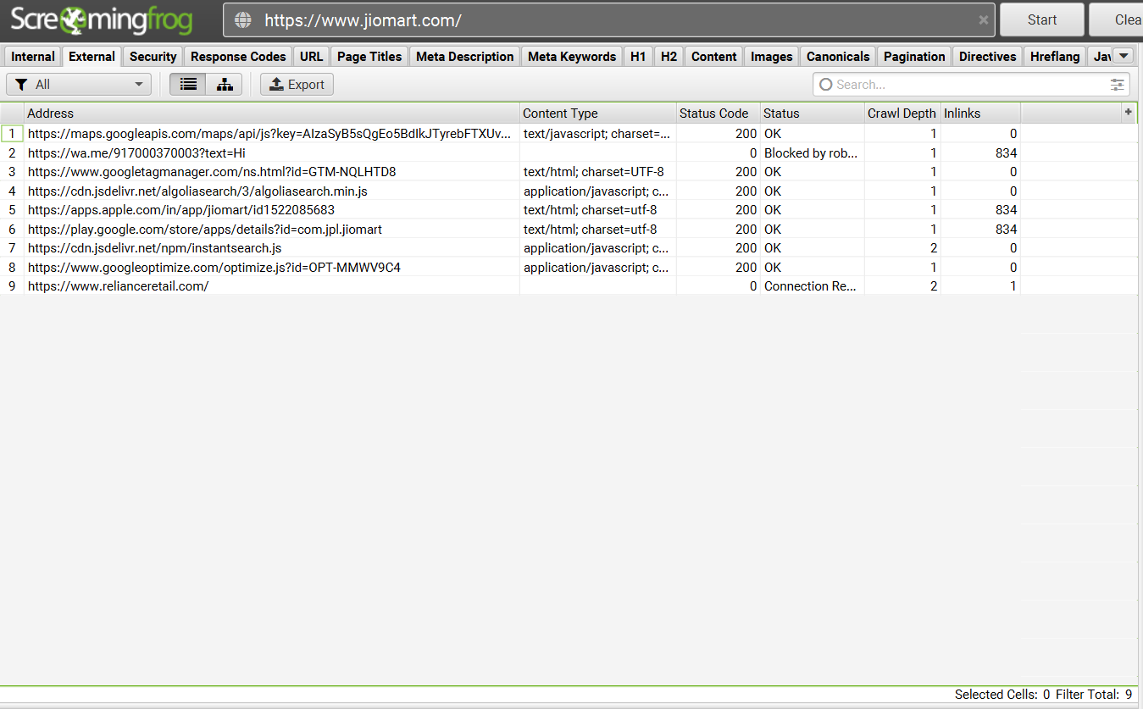
https://www.jiomart.com/
External Links:

Slide 24
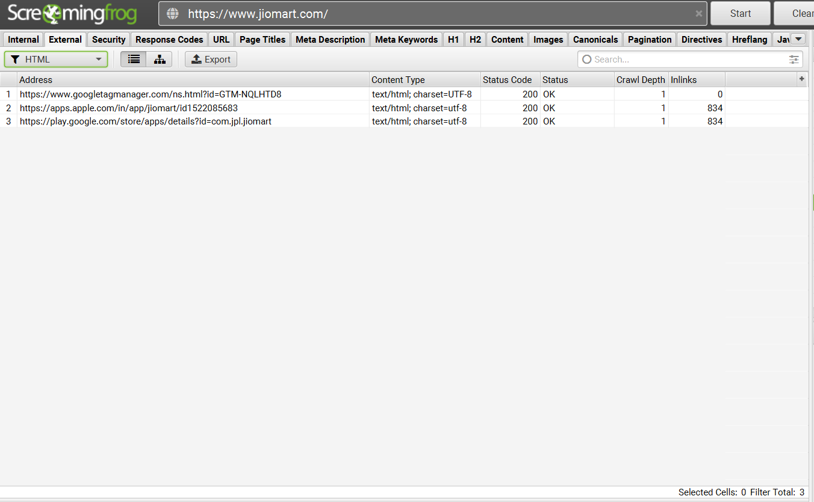
https://www.jiomart.com/
External Links - HTML:

Slide 25
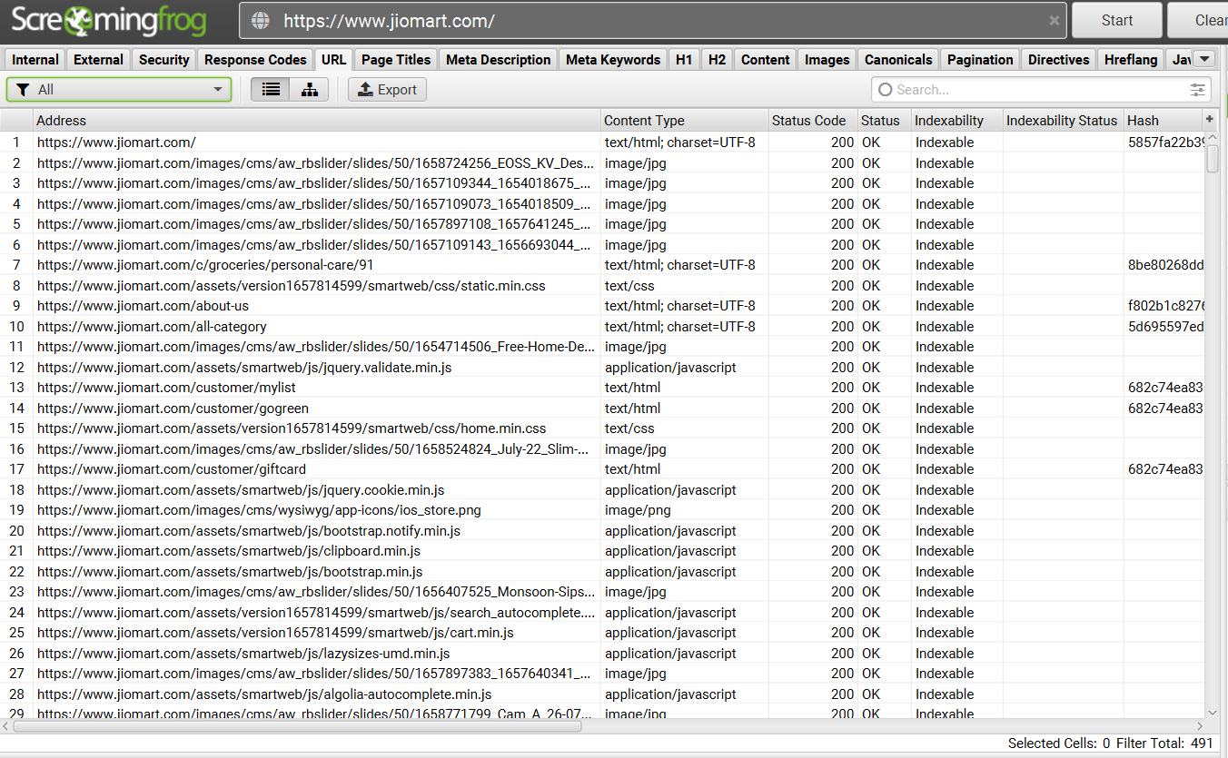
https://www.jiomart.com/
URL:

Slide 26
https://www.jiomart.com/
URL – other options
URL Uppercase – no data
URL NON ASCII Characters – no data
URL Underscore – no data
URL Multiple Slashes – no data
URL Repetitive Path – no data
URL Contains space – no data
URL Parameters – no data
URL Over 115 characters – no data

Slide 27
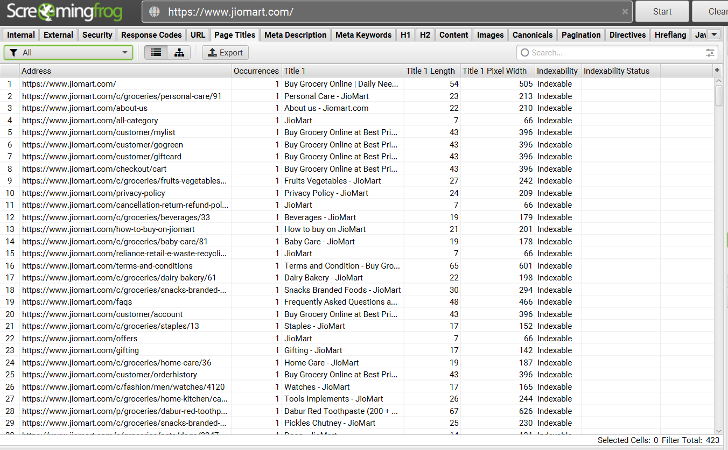
https://www.jiomart.com/
Page Titles:

Slide 28
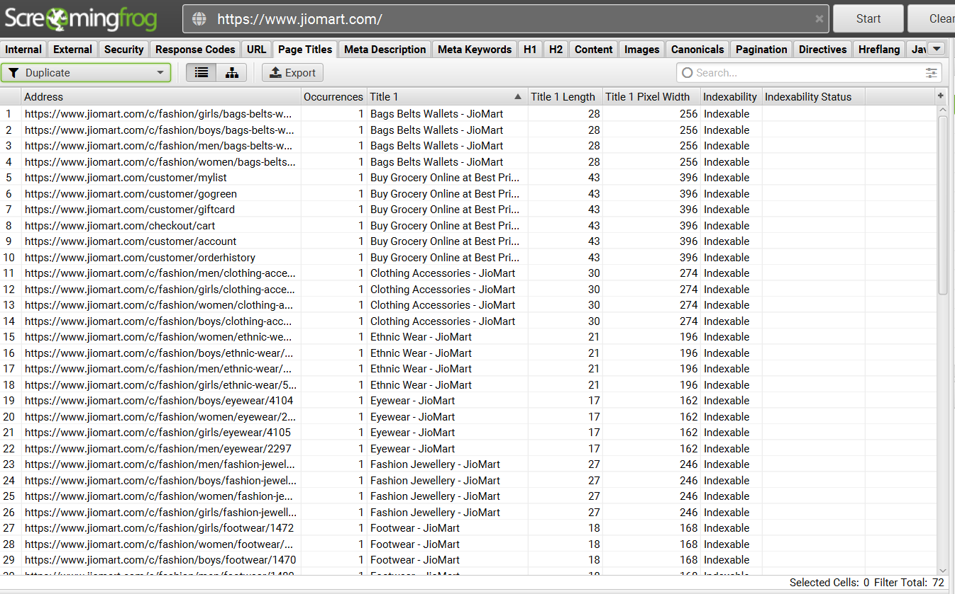
https://www.jiomart.com/
Page Titles - Duplicate:

Slide 29
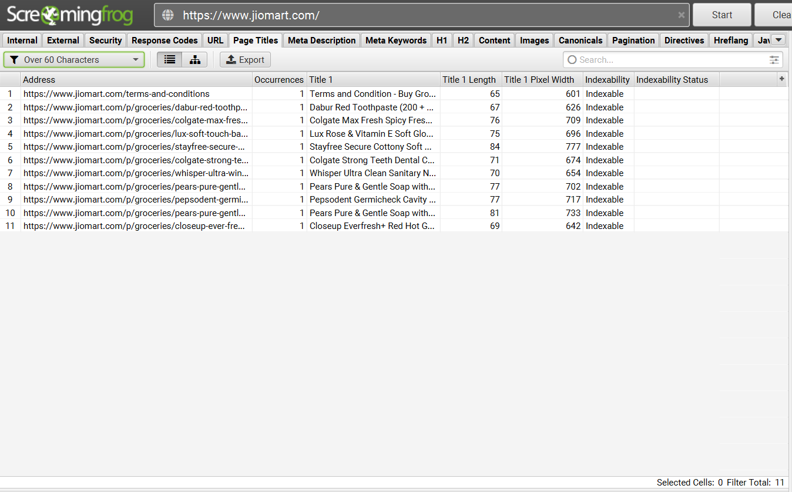
https://www.jiomart.com/
Page Titles– Over 60 Characters:

Slide 30
https://www.jiomart.com/
Page Titles – other options
Page Title – Missing – no data

Slide 31
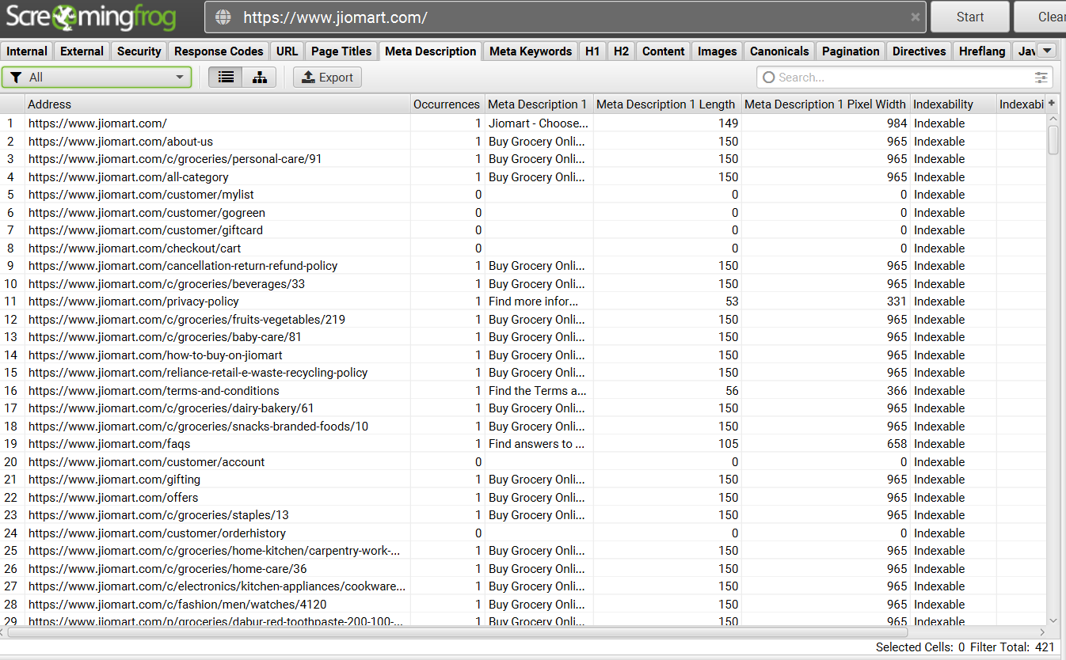
https://www.jiomart.com/
Meta Description:

Slide 32
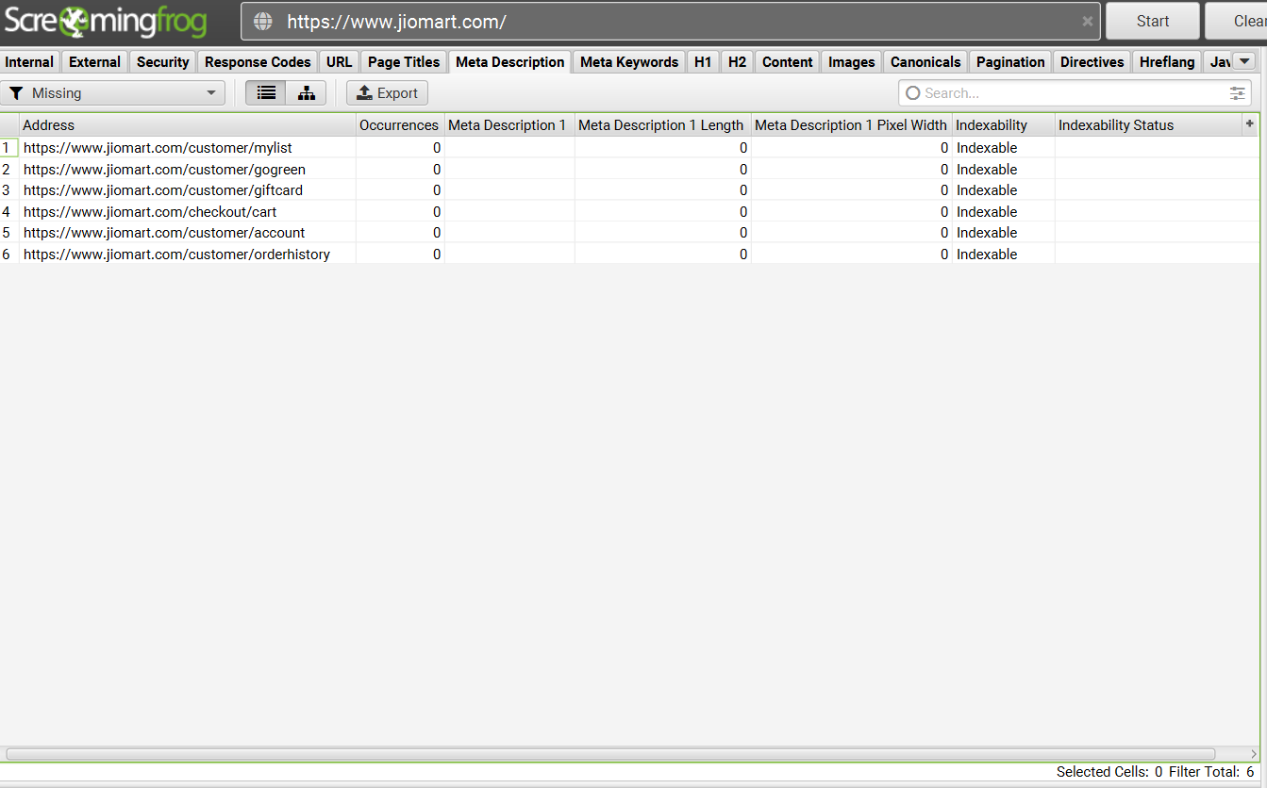
https://www.jiomart.com/
Meta Description - Missing:

Slide 33
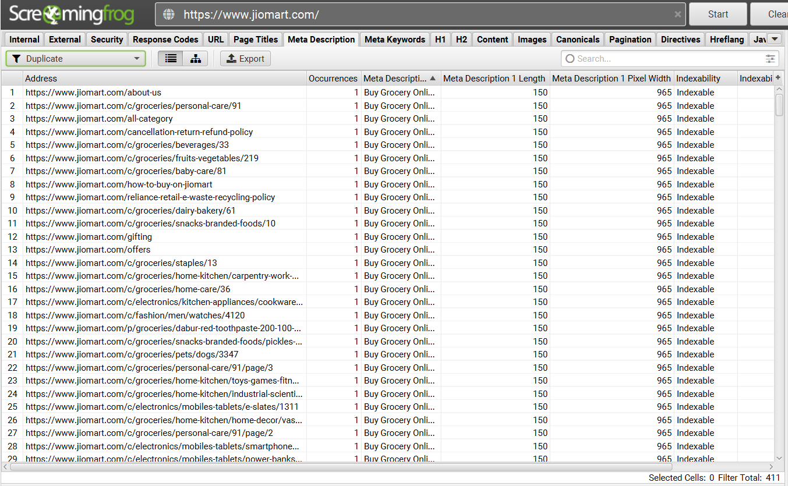
https://www.jiomart.com/
Meta Description - Duplicate:

Slide 34
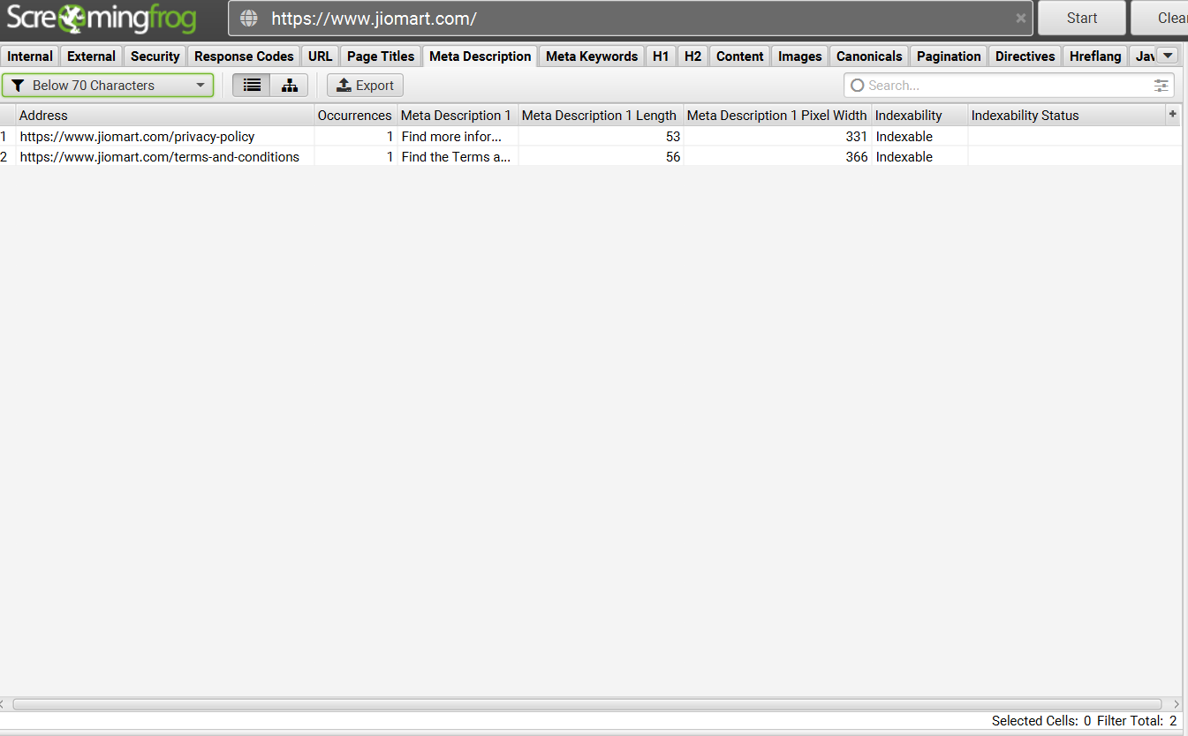
https://www.jiomart.com/
Meta Description – Below 70 characters:

Slide 35
https://www.jiomart.com/
Meta Description – other options
Meta Description – over 155 characters – no data
Meta Description – multiple – no data

